Slide 1
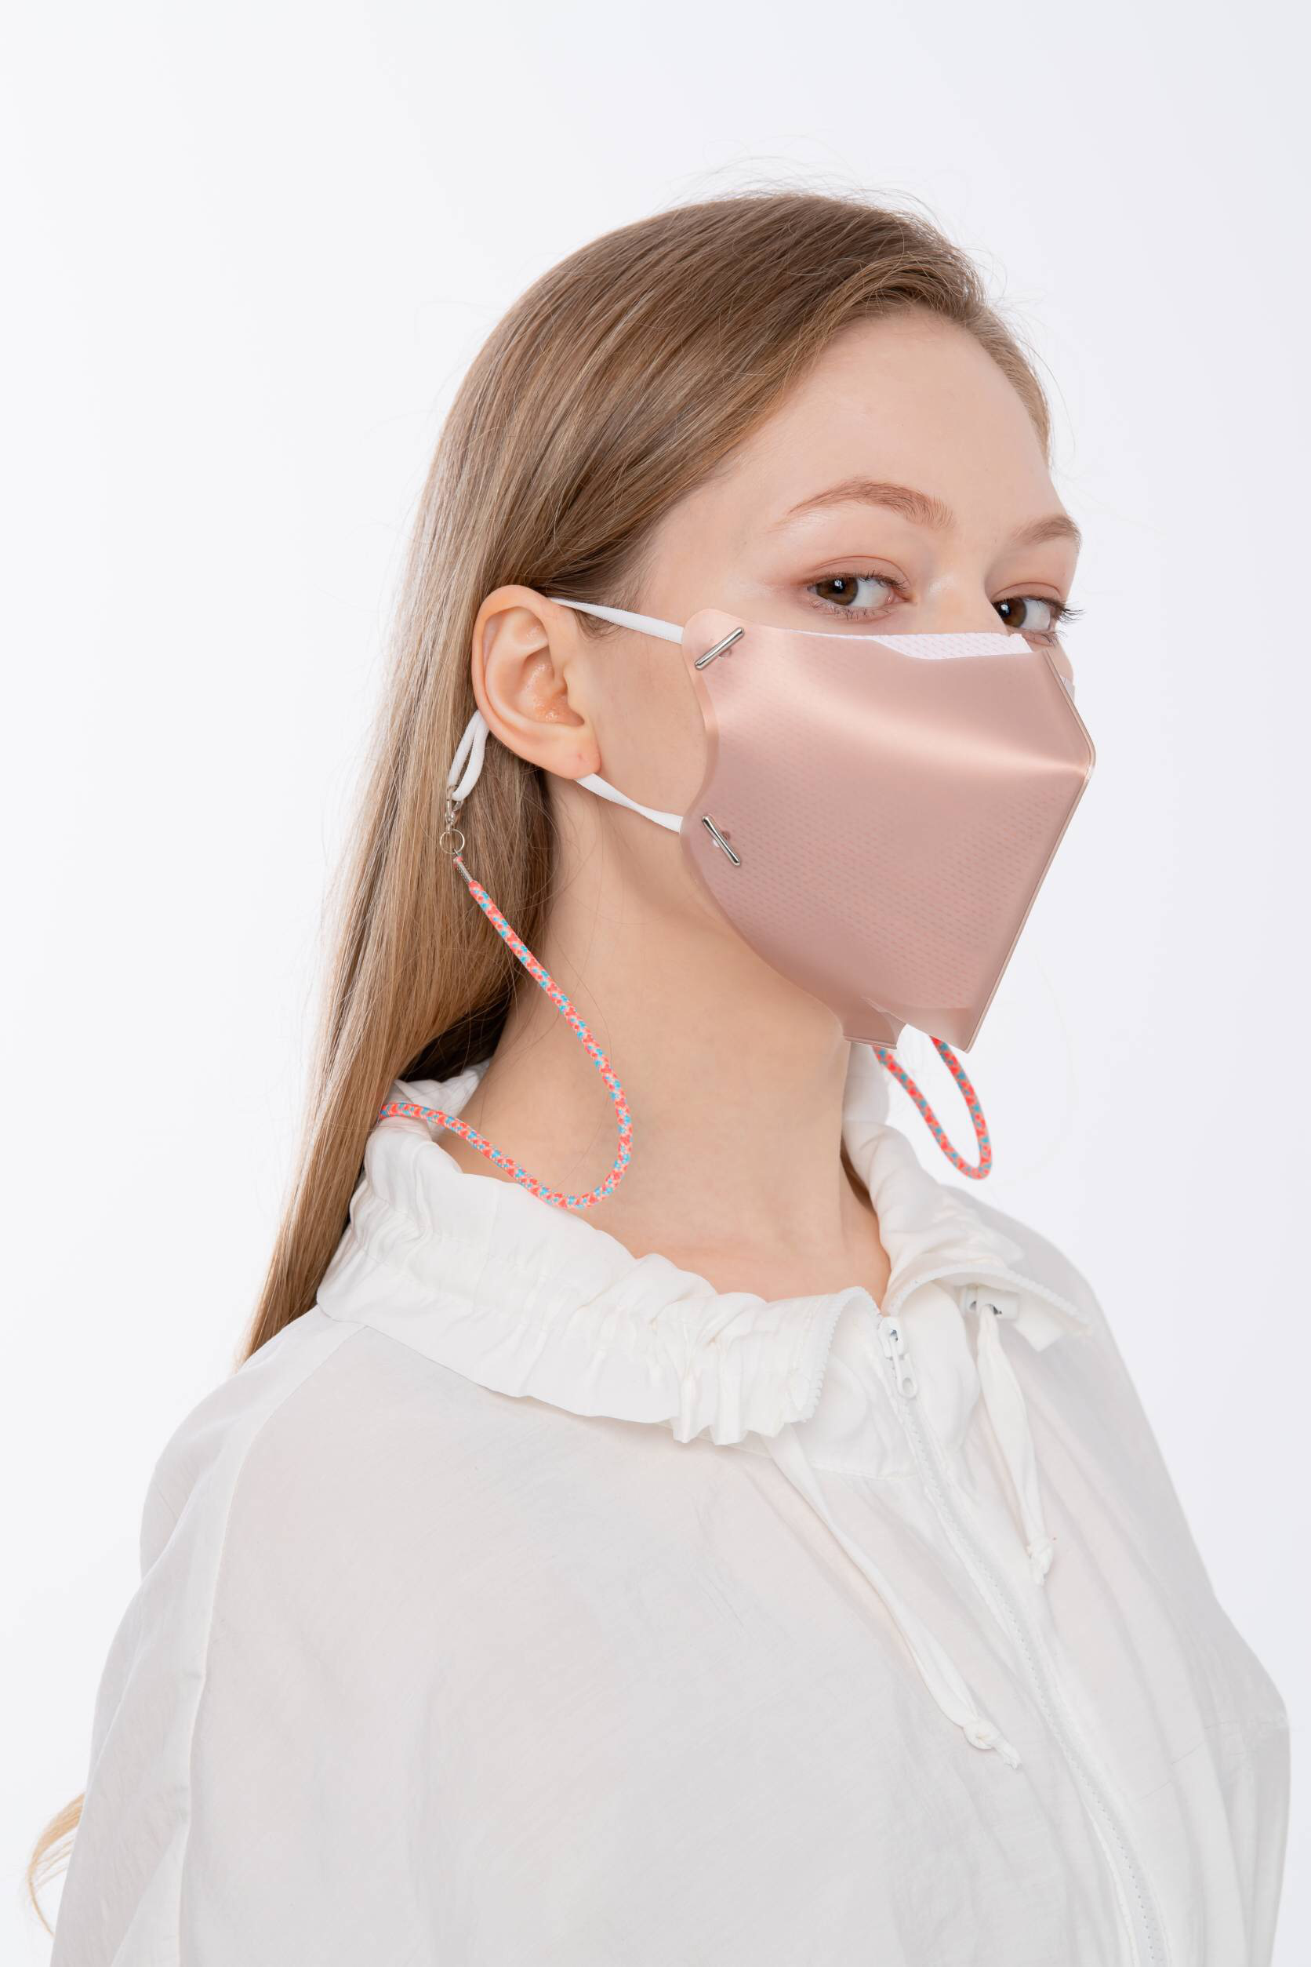
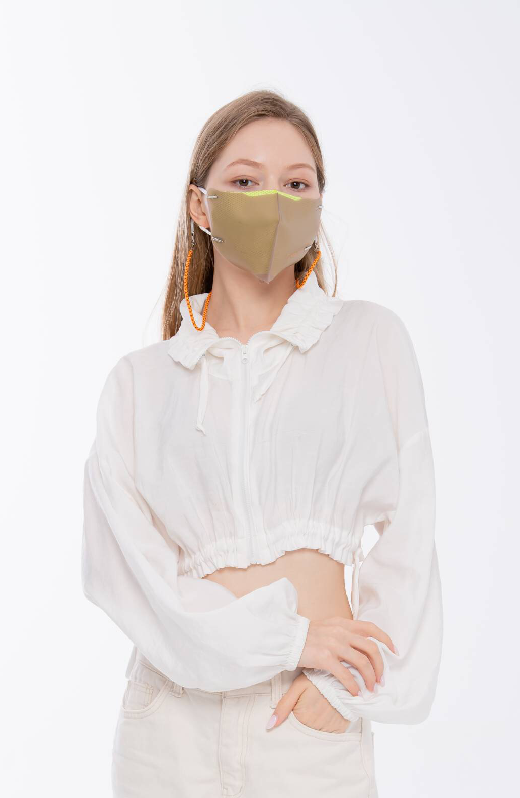
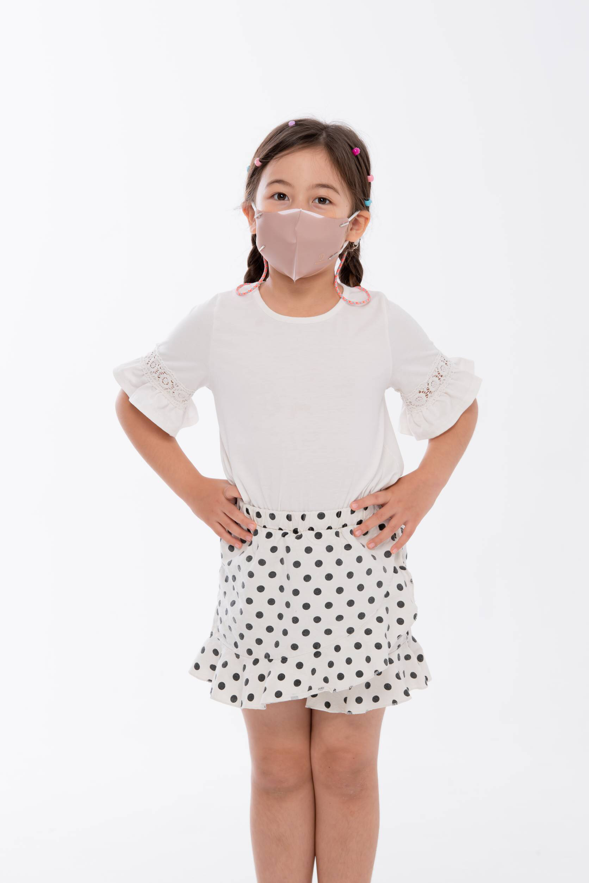
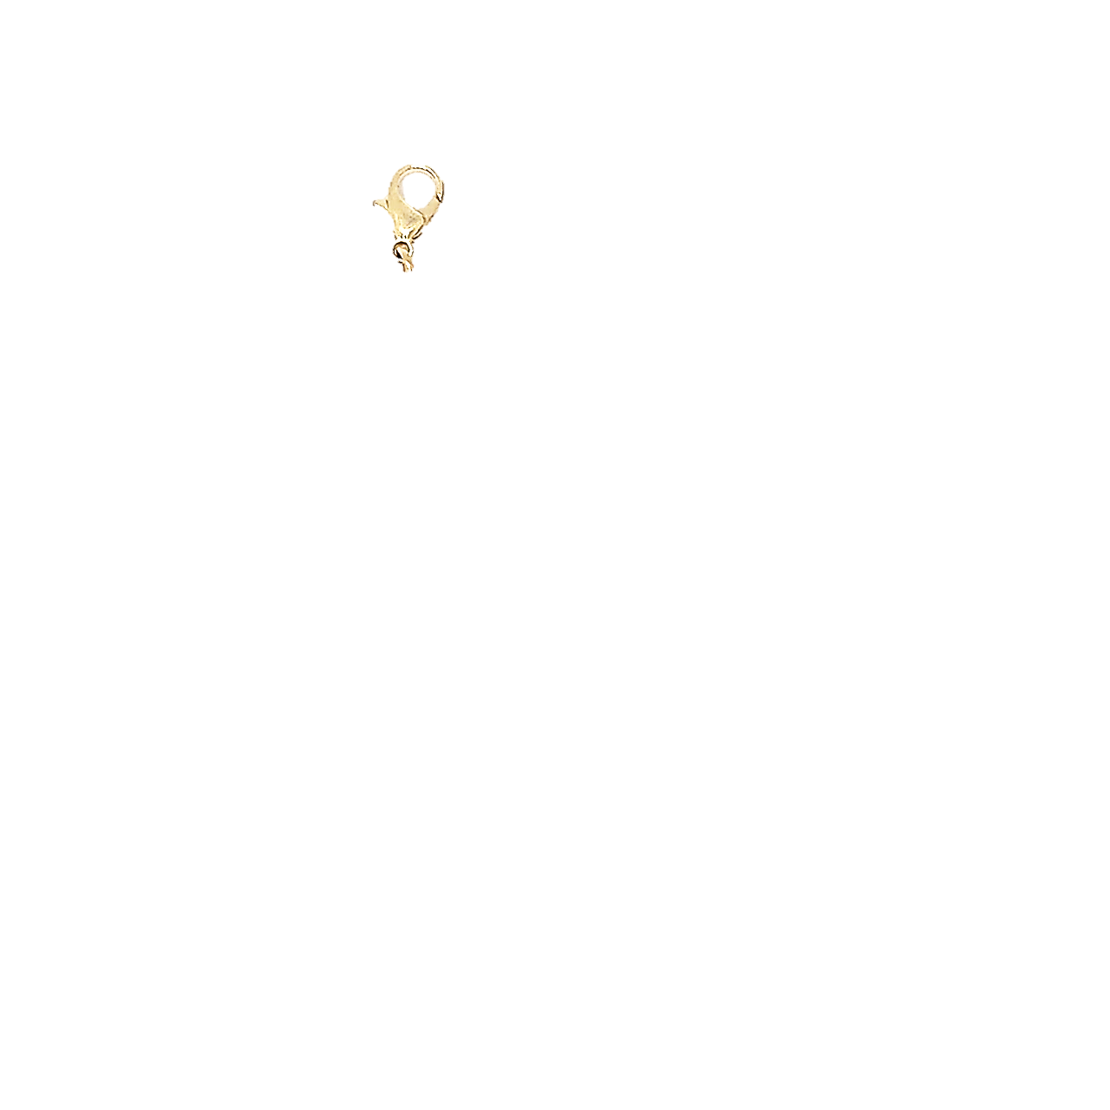
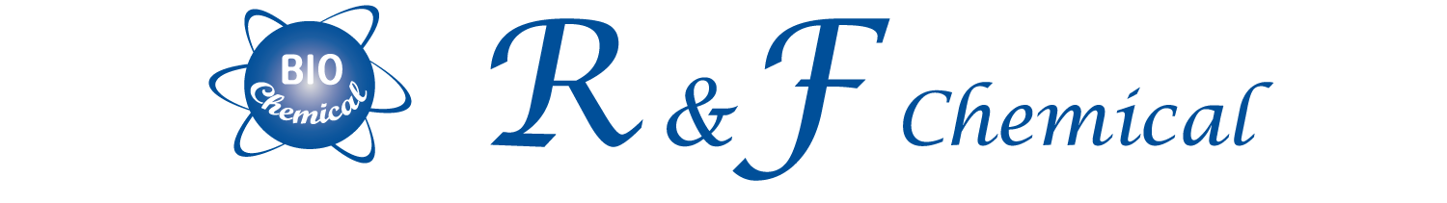

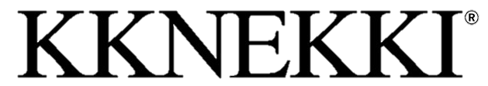
Value Creation From Technology
2020. Version

Slide 2


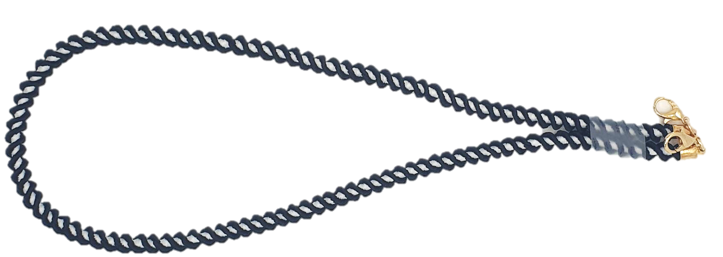
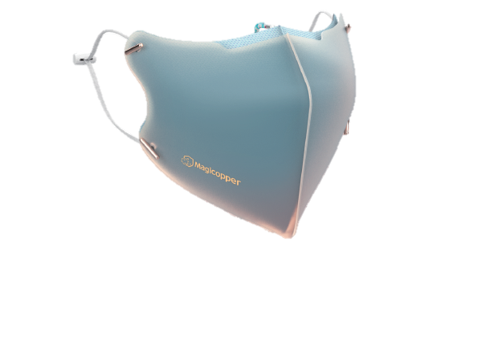
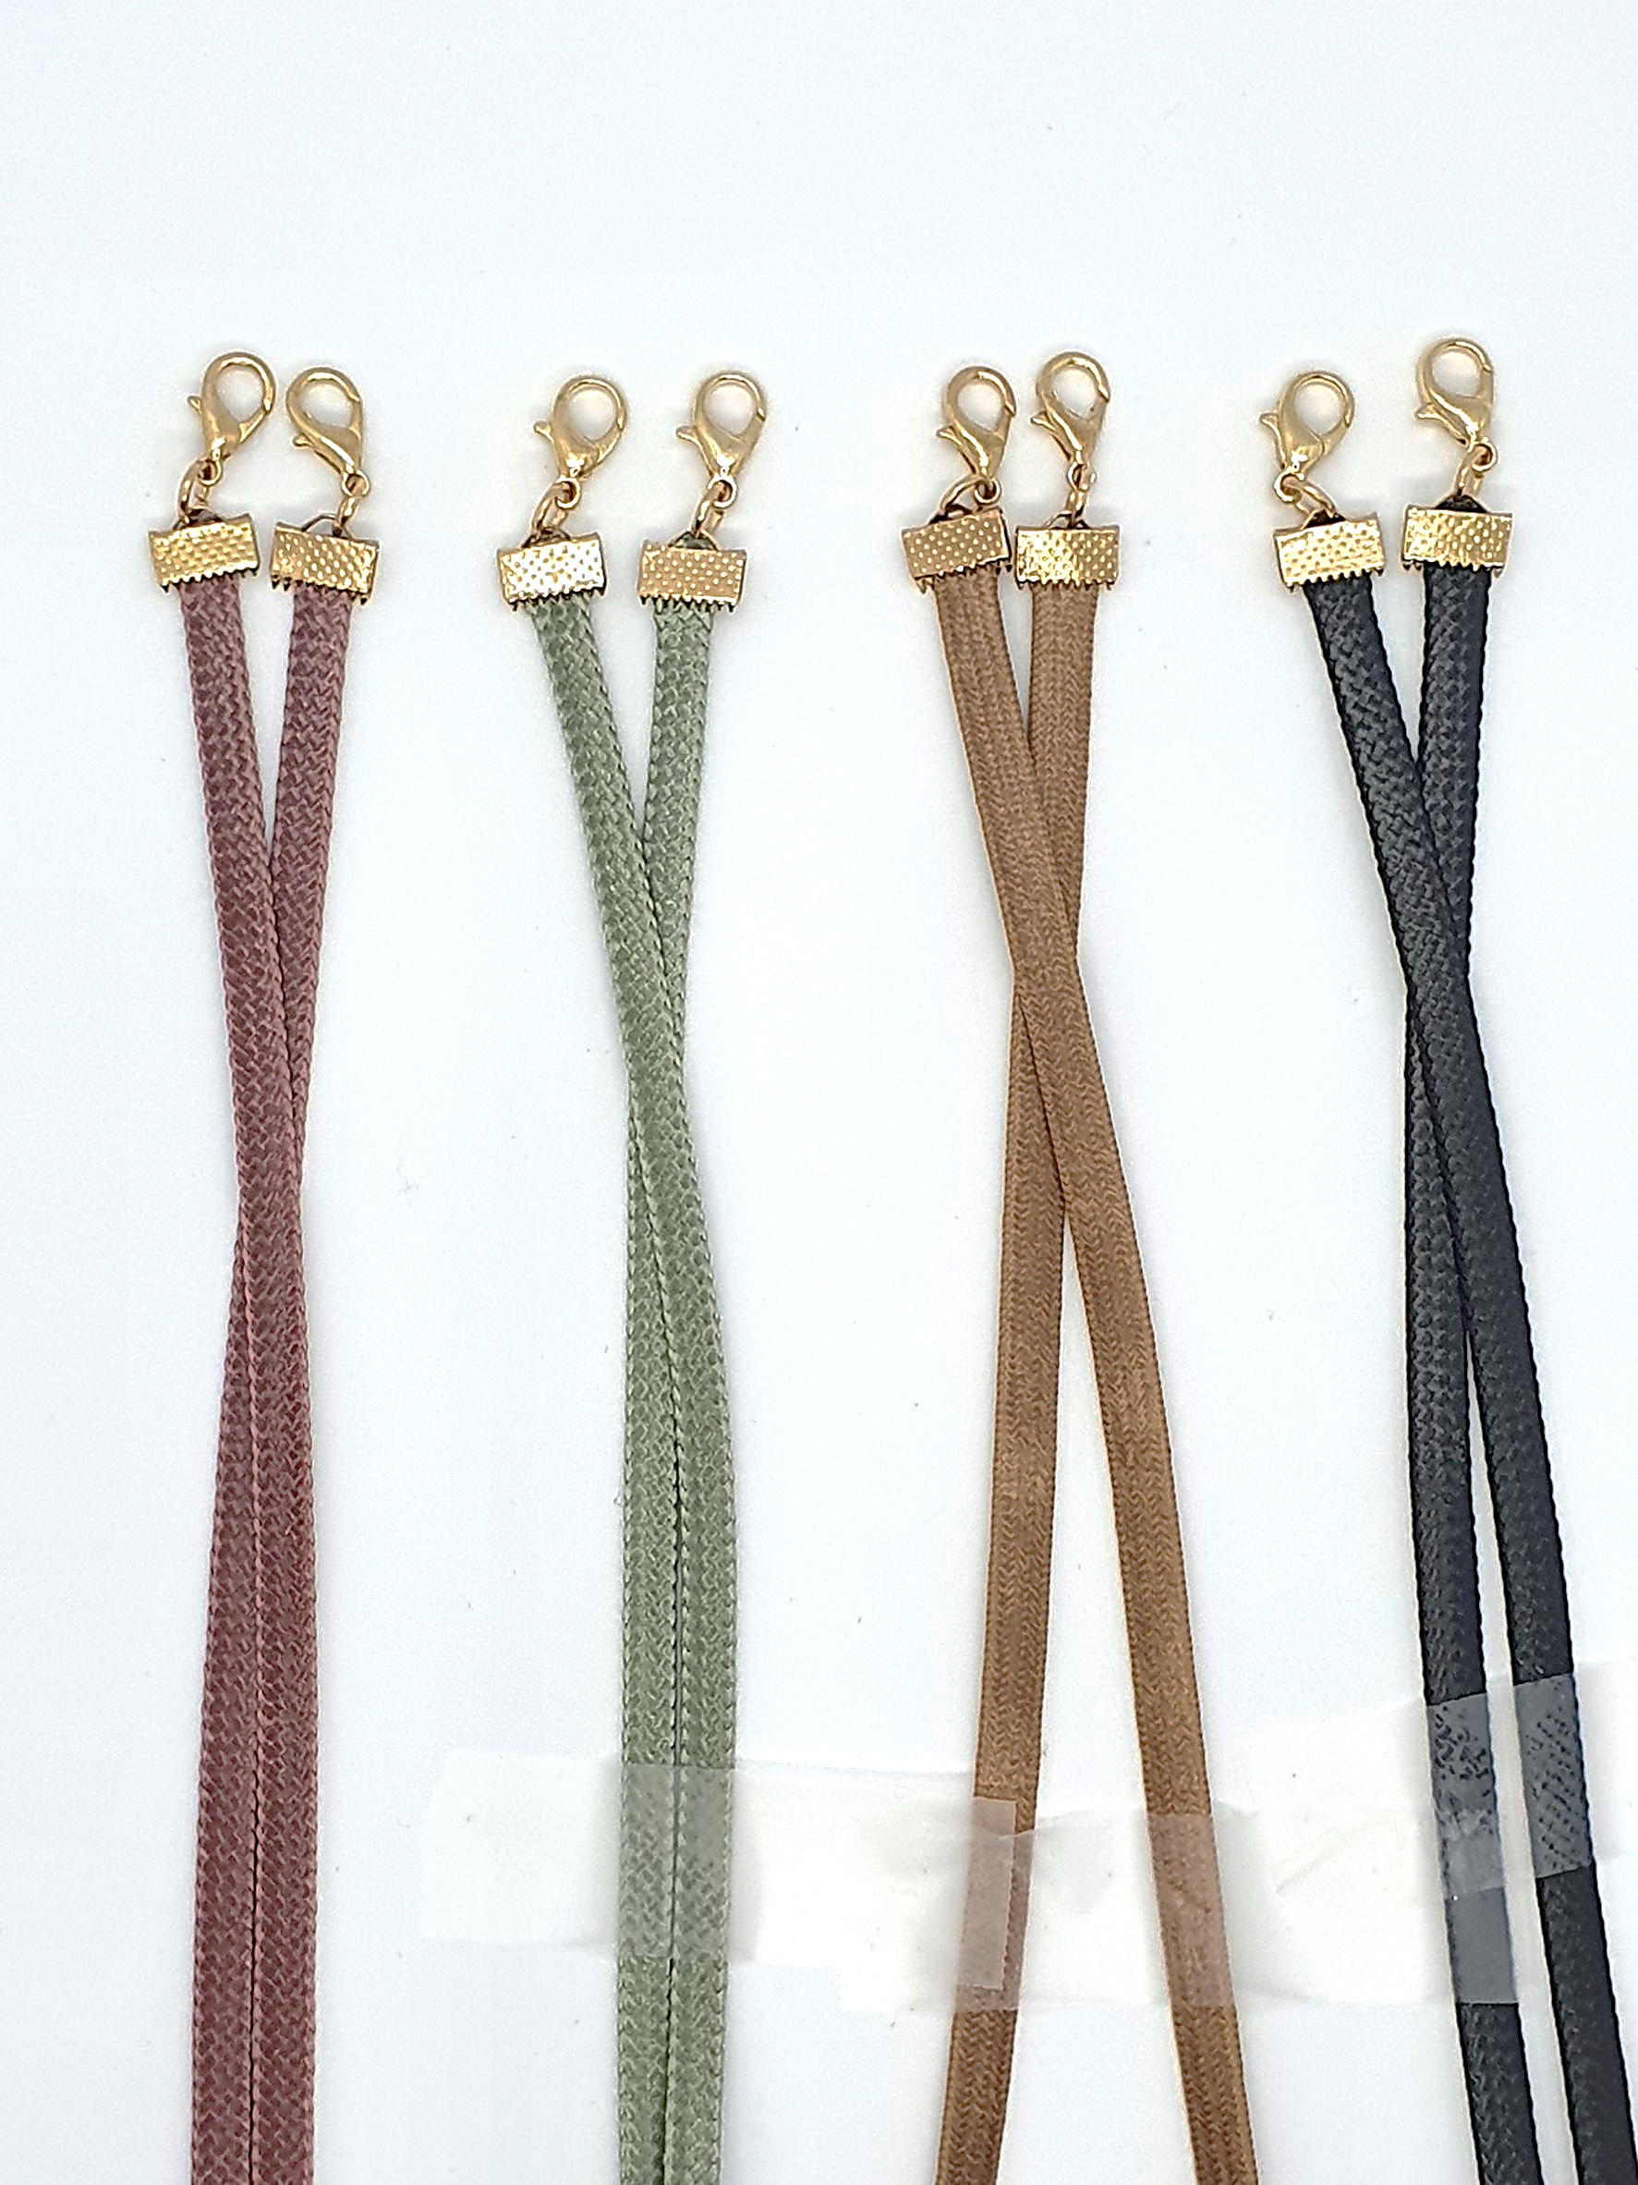



Magicopper MASK & KKNEKKI Necklace SET
MASK
Necklace
Anti-
Virus & Bacteria
Harmless
Easy to breathe
Easy to wash
Colorful Design
Luxurious Pattern
Reusable

Slide 3
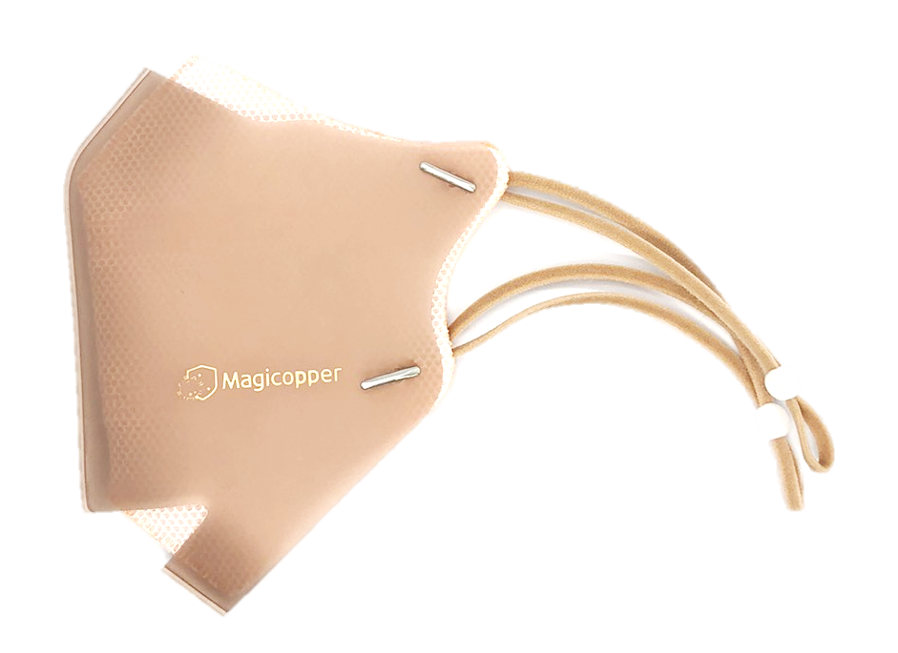
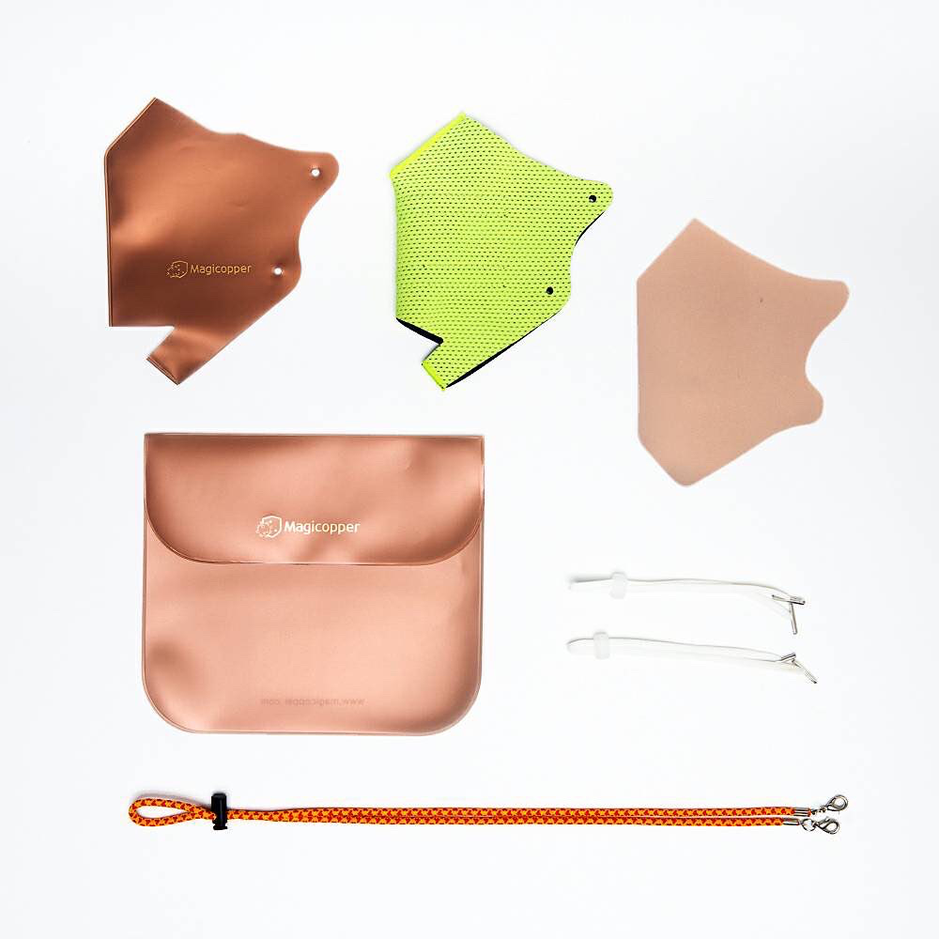
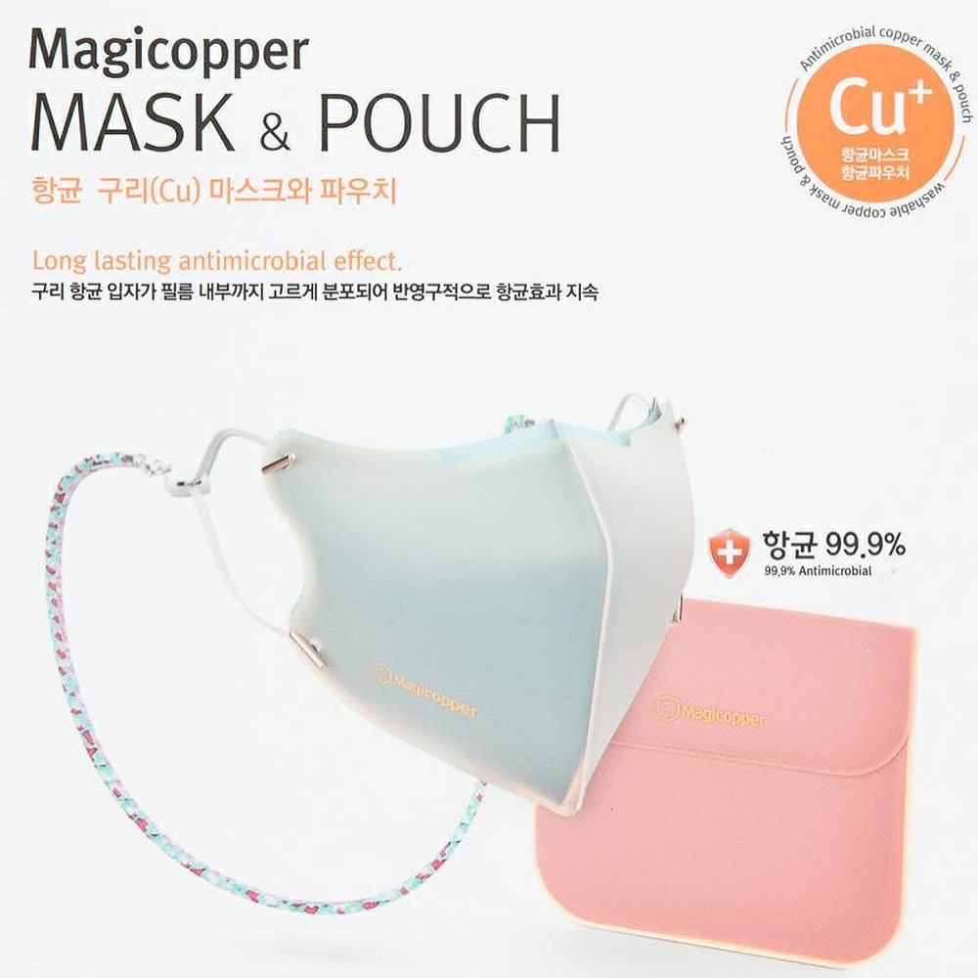
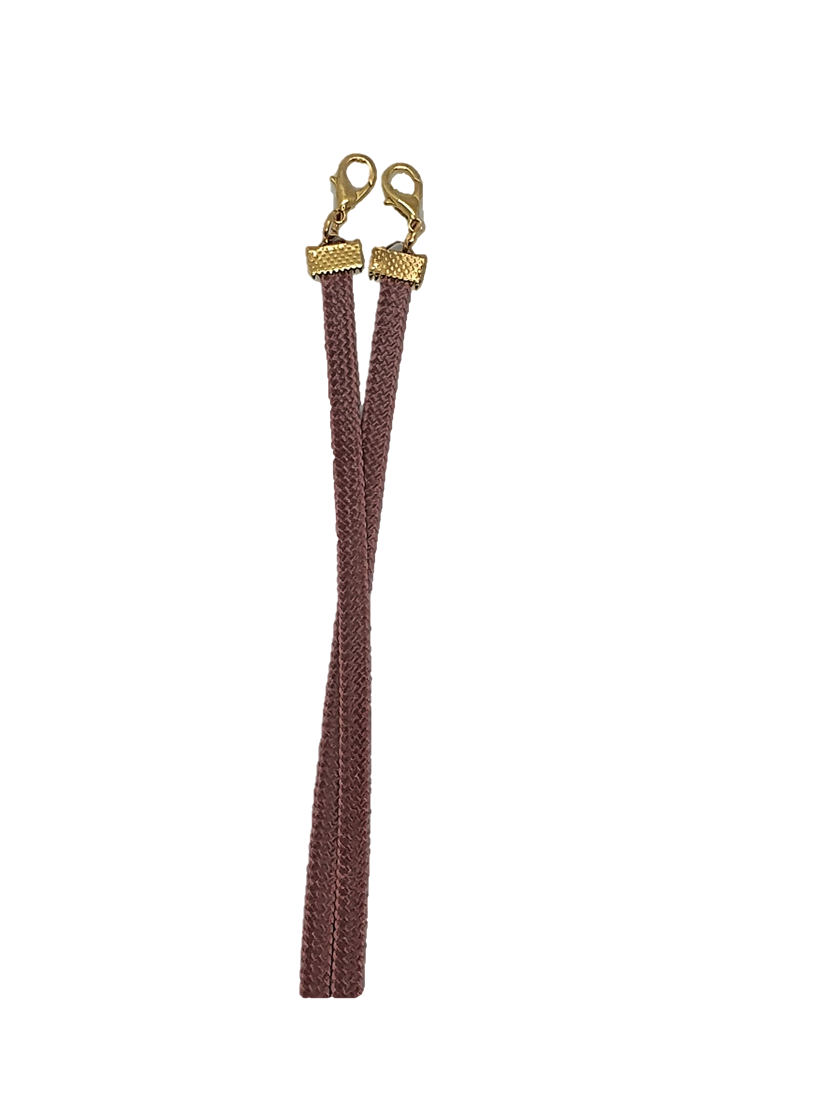

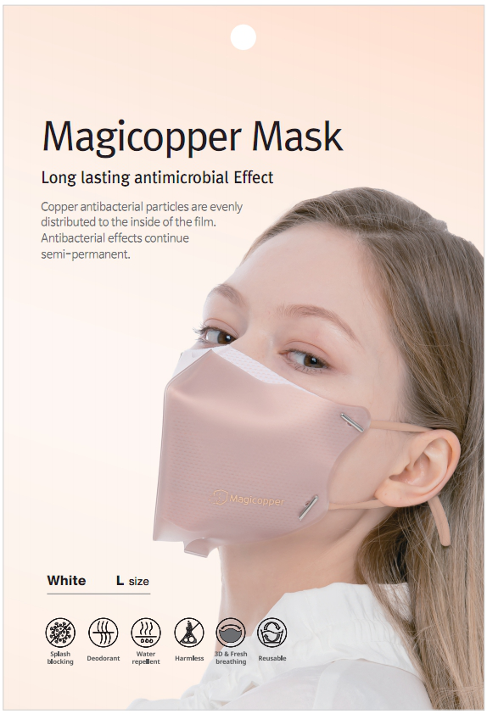
Magicopper MASK & KKNEKKI Necklace SET
 | Product details | Color | Quantity | Package
Magicopper Mask SET (Adult,Kids) |  |  | *MOQ : 800 SET ≤1,920 SET (1PLT) | 80 SET / 1Carton 24 Carton /1PLT (1PLT = 1,920 SET) 10 PLT / 20’ CNTR
 |  |  | ≤9,600 SET (5PLT)
 |  |  | ≤19,200 SET (10PLT)
 |  |  | CNTR Order
Magicopper Mask (Open/Close) |  |  | *MOQ: 2000 pcs ≤ 5,760 pcs (1PLT) | 120 pcs/ 1Carton 48 Carton / 1PLT (1PLT = 5,760 pcs) 10 PLT / 20’ CNTR
 |  |  | ≤28,800 pcs (5 PLT)
 |  |  | ≤57,600 pcs (10 PLT)
 |  |  | CNTR Order
Box Packaging
Mask * 2ea
Mask Case
SKY BLUE
PINK
LIME
Necklace
WHITE
MINT
PET Film Packaging
Mask
Necklace
SKY BLUE
WHITE
*Option : Open / Close

Slide 4
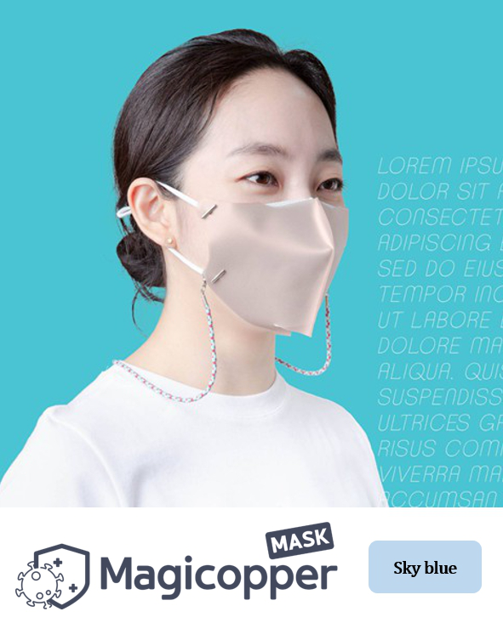
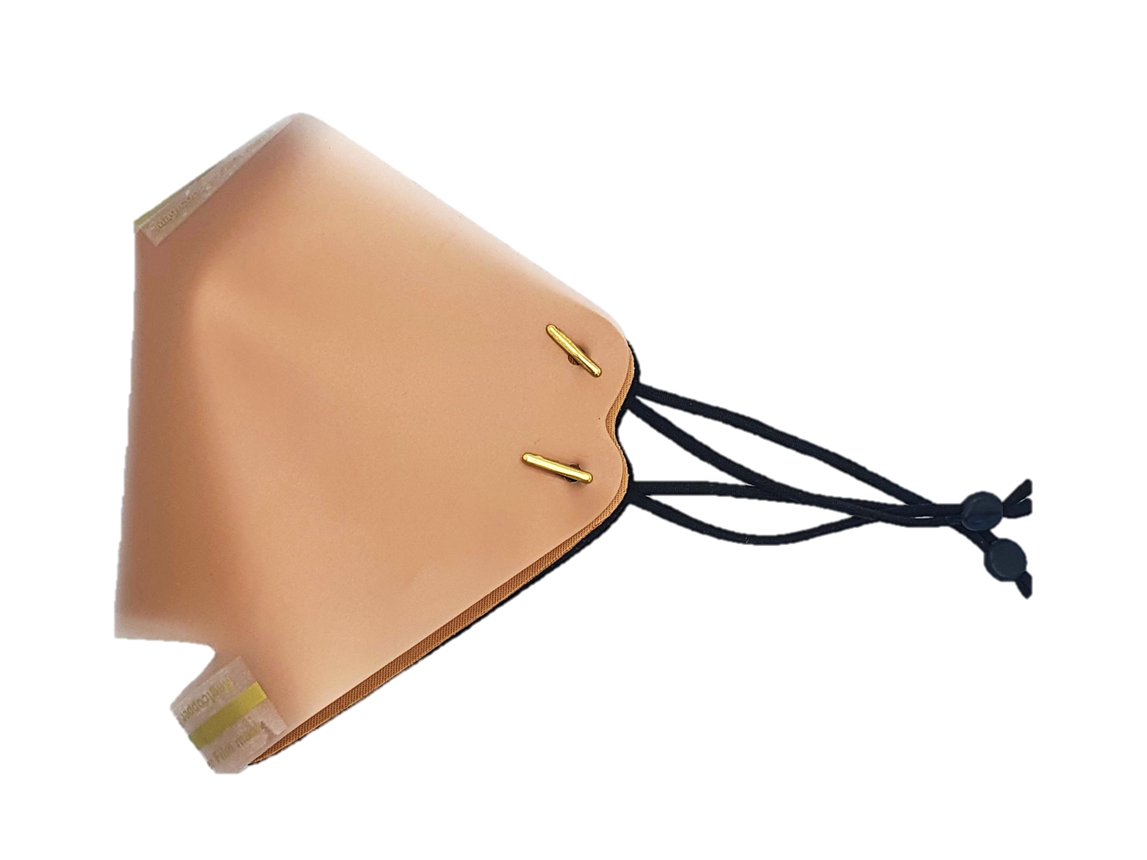
Magicopper MASK & KKNEKKI Necklace SET
 | Product details | Color | Quantity | Carton Package
Mask DIY (Do It Yourself) |  |  | *MOQ : 5,000 ≤ 14,400 pcs (1 PLT) | 300 pcs / 1 Carton 48 Carton / 1 PLT (1PLT = 14,400 pcs) 10 PLT / 20’ CNTR
 |  |  | ≤ 43,200 pcs (3 PLT)
 |  |  | ≤ 72,000 pcs (5 PLT)
 |  |  | CNTR Order
PET Film Packaging
Mask
BEIGE
PINK
*Assembly type
Tape & Ear strap
Beige

Slide 5
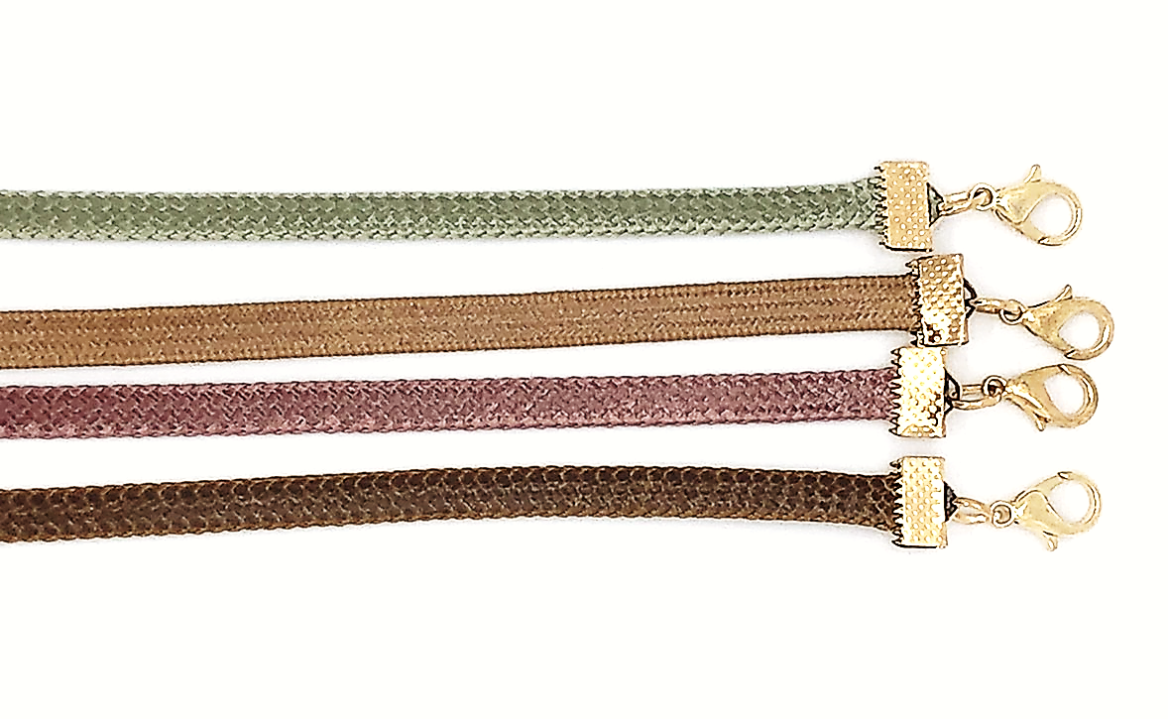
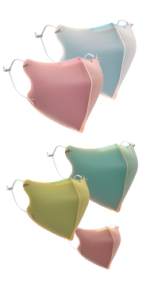
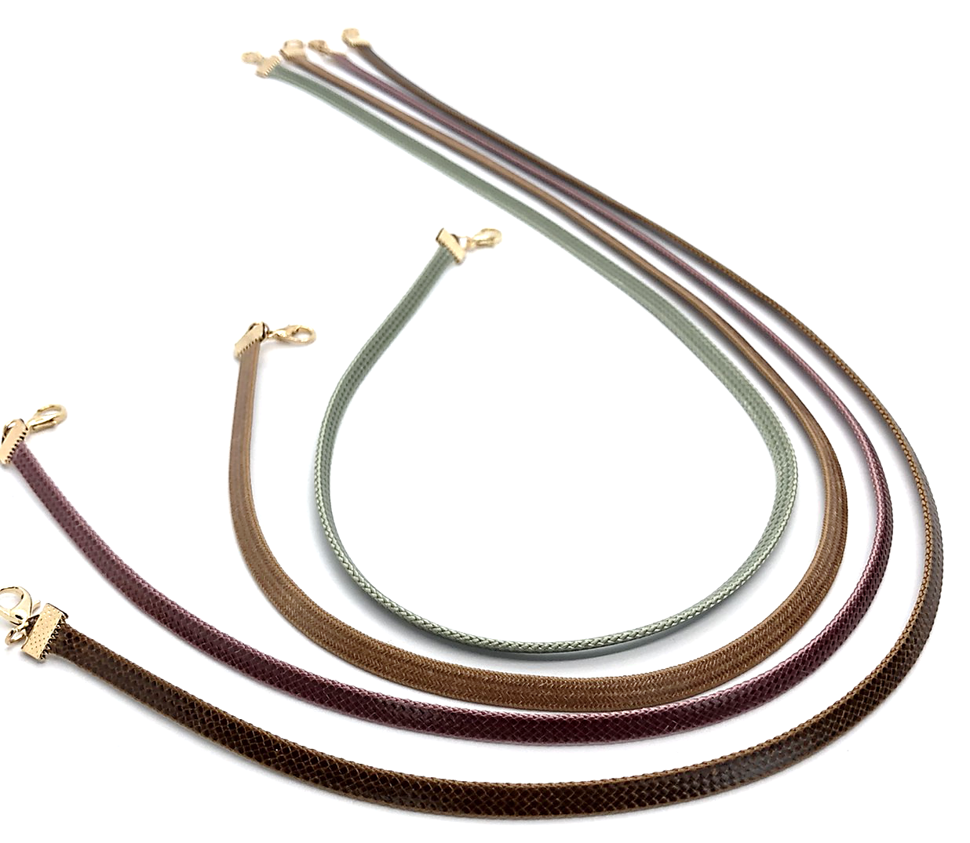

Magicopper MASK & KKNEKKI Necklace Special Benefits
Block Respiratory Droplet
Antibacterial and antiviral effects
No Allergic Reaction
Comfortable & Easy Breathing
Deodorization effect
Prevent Mask from Sticking to Face (Sweat or Saliva)
Prevent Glasses & Goggles from Fogging (Open type)
Long term Usage & Easy to wash
Eco-friendly : Recyclable
Colorful Design : SKYBLUE, PINK, LIME, WHITE, MINT
Special weaving technologies
Luxurious Pattern & Design
Your Unique Choice : ≥40 Options
No Discoloration – UV, Laundry, Sports
No Allergic Reaction : Baby, Kids, Sensitive Skin
Doesn’t easily break or become thin
★ R&F Chemical supplies KKNEKKI Product
: Special mask necklaces, Ear Strap

